Slide 1
Convert a jQuery Library to React Grigori Schneider

Slide 2
Task
Convert the entire Hrnet project to React.
Convert one the four current jQuery plugins to React. Replace the remaining three jQuery plugins with React components.
Perform Lighthouse performance tests comparing the old and the new app.

Slide 3
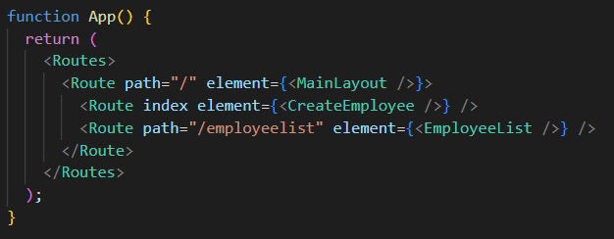
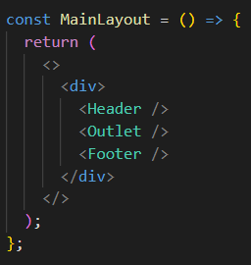
React Router
src/App.js
src/layout/mainLayout.js

Slide 4
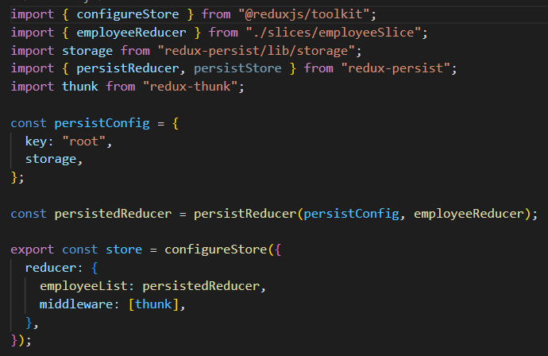
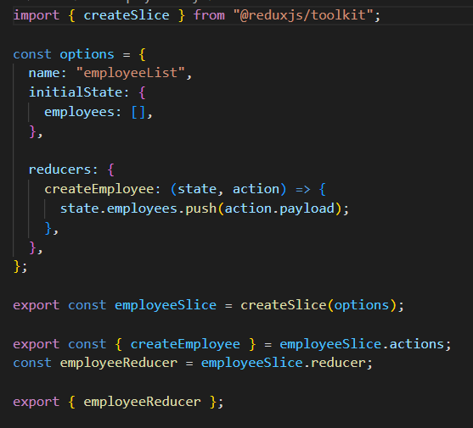
Redux Toolkit / Redux Persist
src/store/store.js
src/store/slices/employeeSlice.js

Slide 5
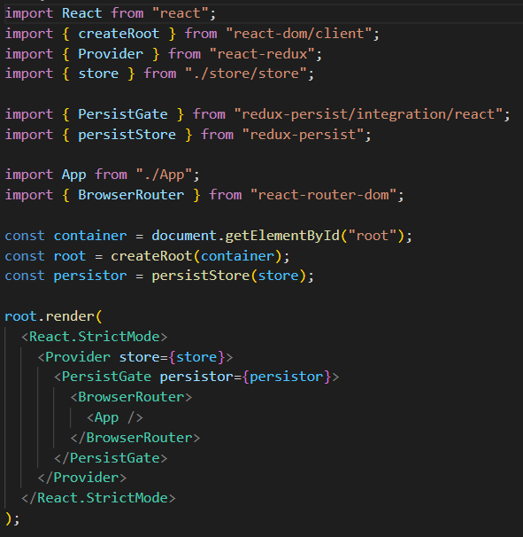
Redux Toolkit / Redux Persist
src/index.js

Slide 6
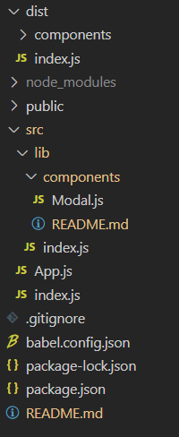
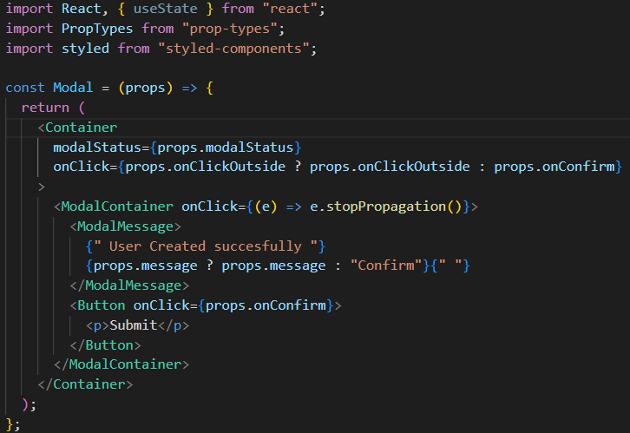
Publish React Component To NPM
.Create an npm account and login from terminal.
Create a react app
Create and isolate components to publish

Slide 7
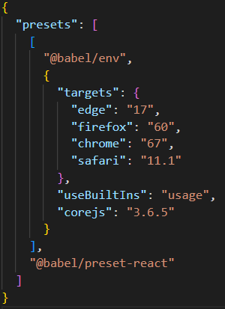
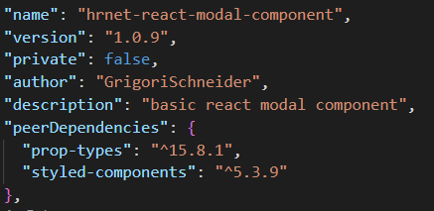
Publish React Component To NPM
babel.config.json
.Install Babel
Alter the package.json for publishing
build the dist folder
package.json

Slide 8
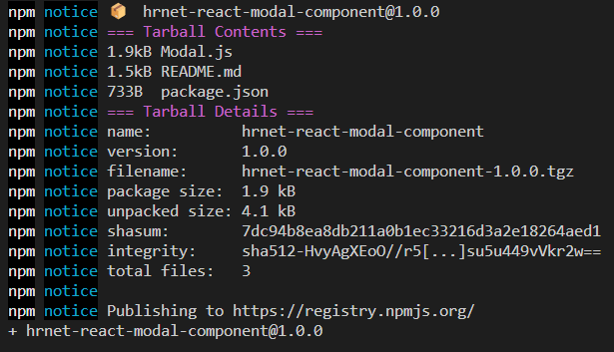
Publish React Component To NPM

Slide 9
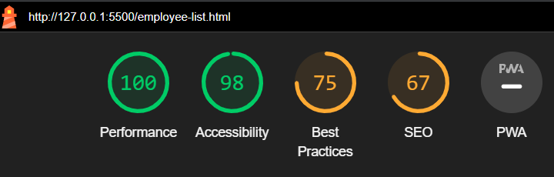
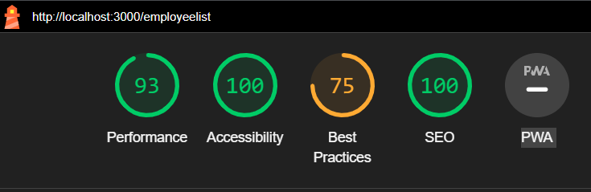
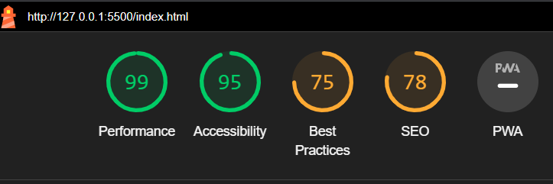
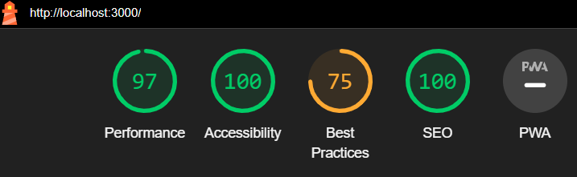
Lighthouse performance tests
Employee List
Create Employee

Slide 10
Thank you!
Q&A

